Slide 1

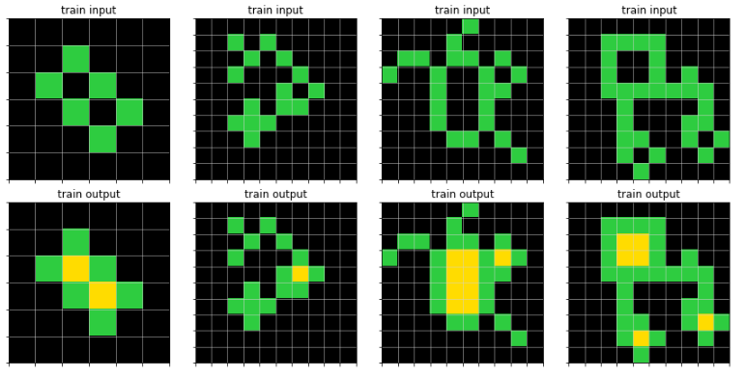
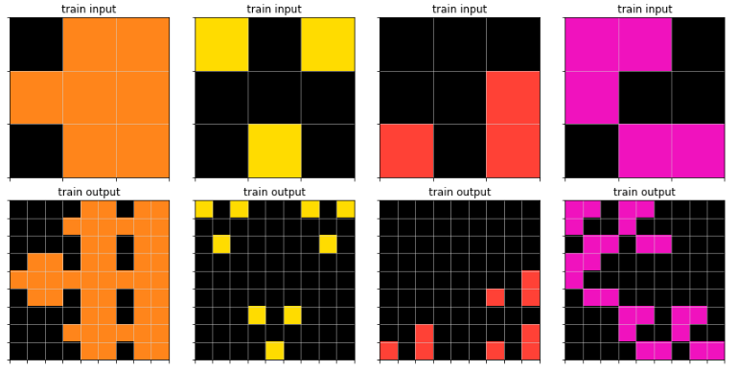
Abstraction and Reasoning Challenge
Kaggle competitions:
Create an AI capable of solving reasoning tasks it has never seen before

Slide 2
Tentative materials and methods

Slide 3
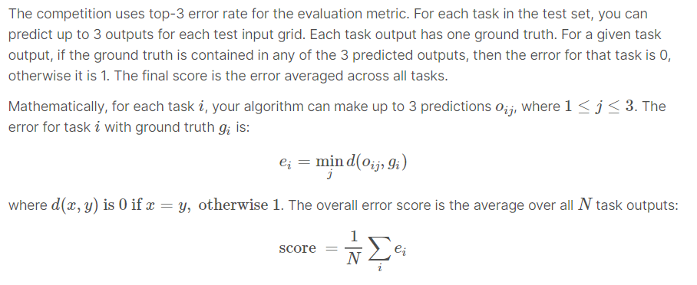
Evaluation dataset and metric

